Slide 1





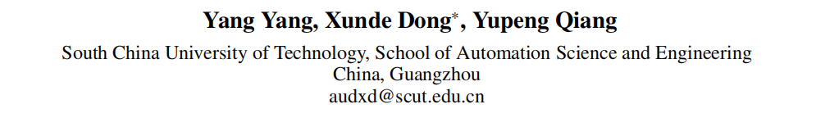





ATAI
Advanced Techniqueof Artificial Intelligence
ATAI
ChongqingUniversity _{AdvancedTechniqueof}
of Technology Artificial Intelligence
Chongqing University of
Technology
Chongqing University ^{ATAI}
_{of Technology} Advanced Techniqueof
Artificial Intelligence
Chongqing University of Technology
Chongqing University of Technology
MSE-Adapter: A Lightweight Plugin Endowing LLMs with the Capability to
Perform Multimodal Sentiment Analysis and Emotion Recognition
Code — https://github.com/AZYoung233/MSE-Adapter
AAAI—2025
Reported by ZhiWei Xu
1

Slide 2

ATAI
AdvancedTechniqueof
Artificial Intelligence
ATAI
ChongqingUniversity _{AdvancedTechniqueof}
of Technology Artificial Intelligence
ChongqingUniversity of Technology
Motivation
1) Significant computational overhead. Large number of trainable parameters and multi-task training lead to considerable computational and multi-task training lead to considerable computational expenses, where UniSA’s pre-training requires three days on eight NVIDIA RTX V100 32G GPUs.
2) Losing the generalization capability inherent to the base models. UniMSE and UniSA, trained respectively on T5 and BART , are tailored for the sentiment analysis domain, restricting these models from performing tasks outside of sentiment analysis.

Slide 3

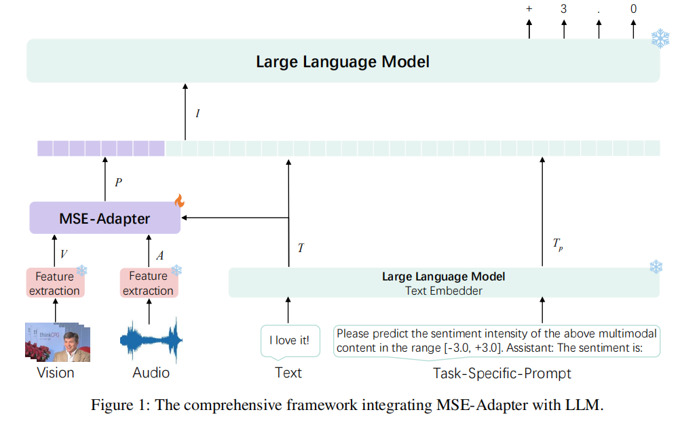
ChongqingUniversity of Technology
ATAI
AdvancedTechniqueof
Artificial Intelligence
ATAI
ChongqingUniversity _{AdvancedTechniqueof}
of Technology Artificial Intelligence
Overview

Slide 4
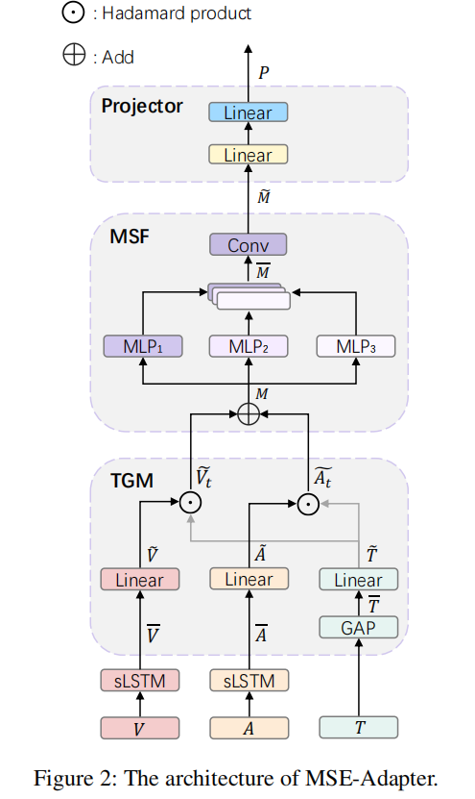
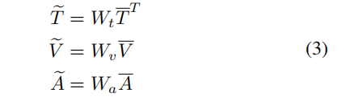



ChongqingUniversity of Technology
ATAI
AdvancedTechniqueof
Artificial Intelligence
ATAI
ChongqingUniversity _{AdvancedTechniqueof}
of Technology Artificial Intelligence
Overview

Slide 5

ChongqingUniversity of Technology
ATAI
AdvancedTechniqueof
Artificial Intelligence
ATAI
ChongqingUniversity _{AdvancedTechniqueof}
of Technology Artificial Intelligence
Method

Slide 6

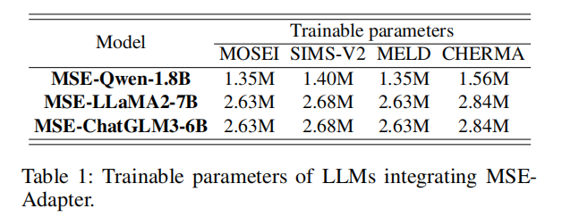
ATAI
AdvancedTechniqueof
Artificial Intelligence
ATAI
ChongqingUniversity _{AdvancedTechniqueof}
of Technology Artificial Intelligence
ChongqingUniversity of Technology
Experiments

Slide 7
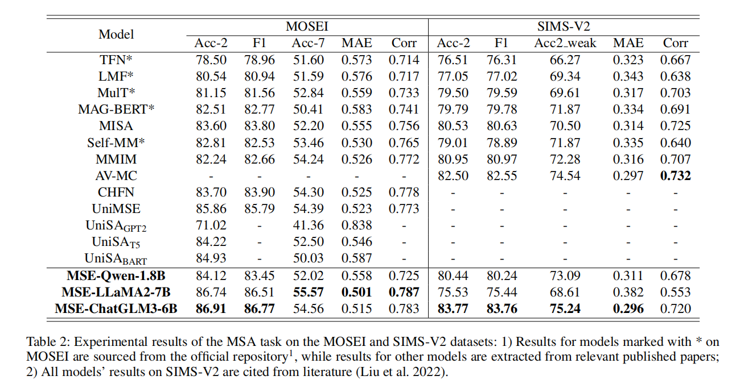
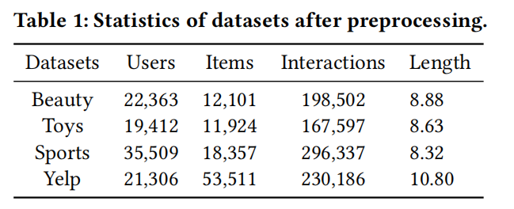
ATAI
AdvancedTechniqueof
Artificial Intelligence
ATAI
ChongqingUniversity _{AdvancedTechniqueof}
of Technology Artificial Intelligence
ChongqingUniversity of Technology
Experiments

Slide 8
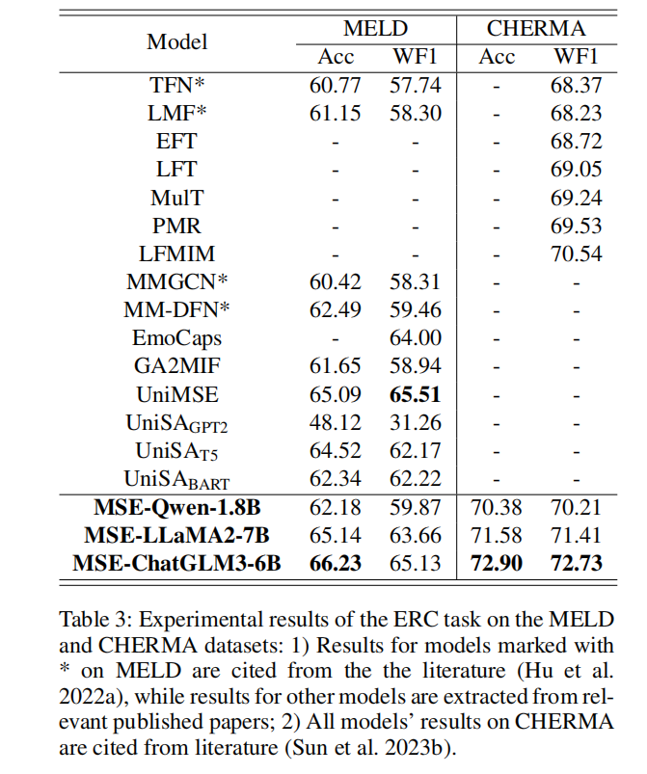
ATAI
AdvancedTechniqueof
Artificial Intelligence
ATAI
ChongqingUniversity _{AdvancedTechniqueof}
of Technology Artificial Intelligence
ChongqingUniversity of Technology
Experiments

Slide 9
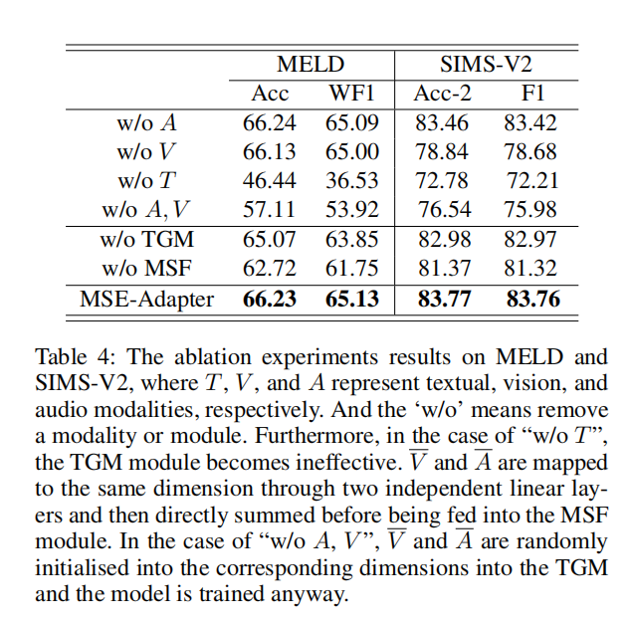
ATAI
AdvancedTechniqueof
Artificial Intelligence
ATAI
ChongqingUniversity _{AdvancedTechniqueof}
of Technology Artificial Intelligence
ChongqingUniversity of Technology
Experiments

Slide 10
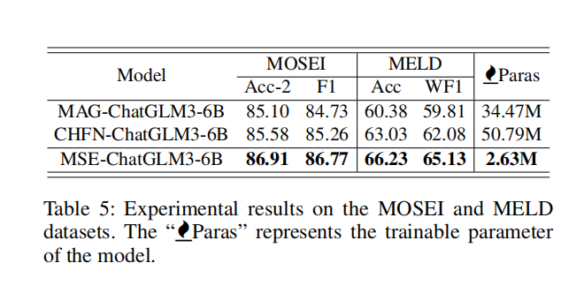
ATAI
AdvancedTechniqueof
Artificial Intelligence
ATAI
ChongqingUniversity _{AdvancedTechniqueof}
of Technology Artificial Intelligence
ChongqingUniversity of Technology
Experiments

Slide 11


ChongqingUniversity of Technology
ATAI
AdvancedTechniqueof
Artificial Intelligence
ATAI
ChongqingUniversity _{AdvancedTechniqueof}
of Technology Artificial Intelligence
Thanks!

